Slide 1





Analyse technique
Repository Pattern

Slide 2
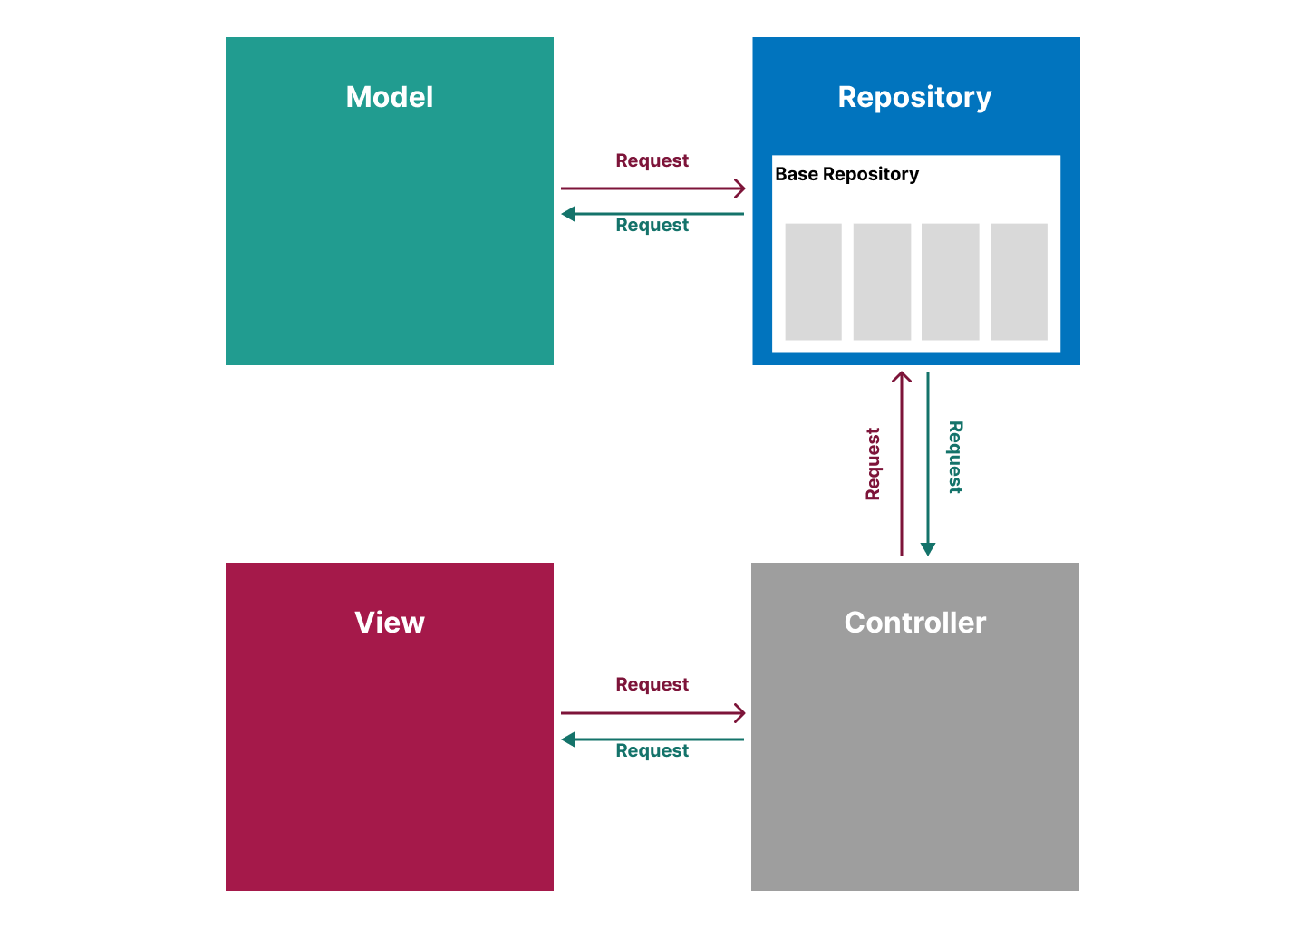
Repository Pattern

